Slide 1
PV260 - SW Quality
Team 4 - Popocatepetl

Slide 2
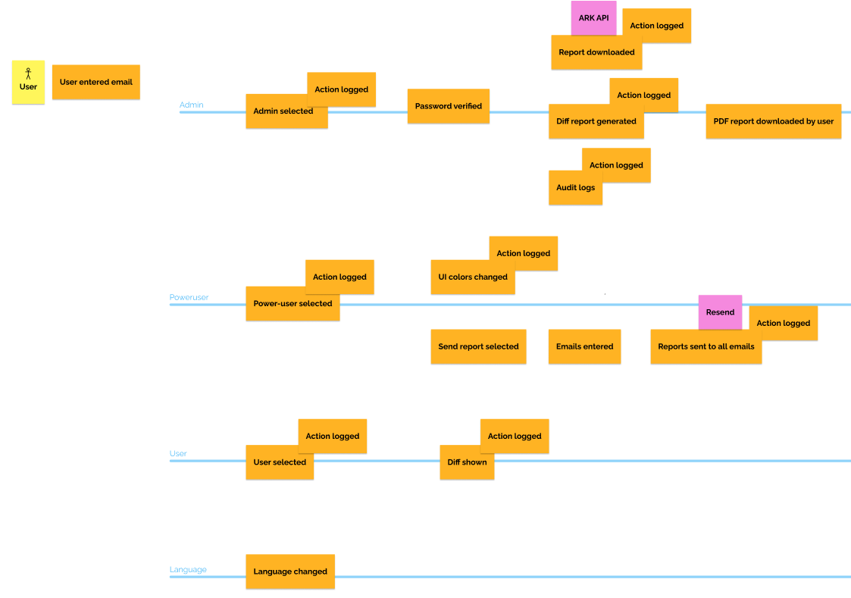
Project assignment

Slide 3
Architecture & Technologies
Clean architecture
CQRS
API & CLI presentation layers
Resend
Spectre.Console

Slide 4
Live Demo
Download application
Login
Admin: Download and generate diff. report
Power user: Send email with last diff. report
Power user: Change UI theme
User: See last diff. report
Change language
Admin: Audit logs

Slide 5
Q&A

